Slide 1

Certification of Avionics Embedded Systems
In collaboration with Marinvent Corporation
It’s Only Software!

Slide 2
Certification of Avionics Embedded Systems
In collaboration with Marinvent Corporation
Chapter 3.1
RTCA/DO-178B
SOFTWARE CONSIDERATION IN AIRBORNE SYSTEMS AND EQUIPMENT CERTIFICATION
presented by :
John Maris
john@marinvent.com

Slide 3

Caution
    This module is designed to show the application of the certification principles contained in the others chapters. As such, it touches upon many aspects of the certification process, but the material is not complete, comprehensive, or necessarily current with the latest regulations and guidance materials. For these reasons, the analysis contained in the following slides should not be used as the basis of a certification program for the system under investigation.

Slide 4
Overview
    3.1 RTCA/DO-178B
      3.1.1 Introduction to RTCA/DO-178B
      3.1.2 RTCA/DO-178B Justifications
      3.1.3 Key Definitions and Concepts
      3.1.4 Failure Conditions and Software Levels
      3.1.5 Failure Severity vs. Probability
      3.1.6 Summary

Slide 5
3.1.1 Introduction to RTCA/DO-178B
Three definitions of RTCA/DO-178B:
  “Software Considerations in Airborne Systems and Equipment Certification”
  The least understood certification document ever produced
  The most work ever packed into approximately 100 pages

Slide 6
3.1.1 Introduction to RTCA/DO-178B (cont’d)
Prepared “through a consensus process”
  by RTCA Special Committee 167 and European Organisation for Civil Aviation Equipment (EUROCAE)
  Approved on December 1, 1992.
The findings of RTCA are in nature of recommendations to all organizations concerned…
  RTCA is not an official agency United States Government…
This document recognizes that:
  It is not mandated by law, but is a consensus of aviation community.
  that alternative methods may be available to applicant…
Since certification issues are discussed only in relation to the software life cycle, the operational aspects of the resulting software are not discussed.

Slide 7
3.1.1 Introduction to RTCA/DO-178B (cont’d)
The purpose
  Provide guidelines for production of software for airborne systems and equipment that performs its intended function with a level of confidence in safety that complies with airworthiness requirements
The form
  Objectives for software life cycle processes
  Descriptions of activities and design considerations for achieving those objectives
  Descriptions of evidence that indicate that objectives have been satisfied

Slide 8
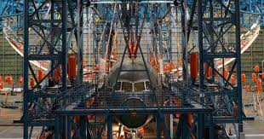
3.1.2 RTCA/DO-178B Justifications
Hardware certification relies on combination of analysis, simulation, and testing to demonstrate compliance and safety:
25 ft
Figure 3.1.1 – Boeing 787 before test

Slide 9
3.1.2 RTCA/DO-178B Justifications (cont’d)
Software certification presents us with some unique problems:
  How do we “analyse” software, in the way we would analyse an aircraft structure?
  How do we “test” software by stressing it to 150% of its expected limit load, which is what we do for wings, for example?
  How do we “prove” software has a reliability of 10⁻⁹, as might be required for a critical system?

Slide 10
3.1.2 RTCA/DO-178B Justifications (cont’d)
Addressed these issues by matching the required “Software Levels” (‘E’ to ‘A’) to corresponding “Failure Condition Categories” (‘No Effect’ to ‘Catastrophic’).
Defines rigor of life-cycle processes corresponding to each software category, and makes assertion that, if properly followed, processes will achieve the required level of safety corresponding to category.

Slide 11
3.1.2 RTCA/DO-178B Justifications (cont’d)
As DO-178B states:
  “Software level is based upon the contribution of software to potential failure conditions as determined by the system safety assessment process. The software level implies that the level of effort required to show compliance with certification requirements varies with the failure condition category.”

Slide 12
3.1.3 Key Definitions and Concepts
The following slides define the Failure Condition Categories, along with their equivalent Software Level Definitions, as used in RTCA/DO-178B.

Slide 13
3.1.4 Failure Conditions and Software Levels
No Effect
  Failure conditions which do not affect the operational capability of the aircraft or increase crew workload.
Level E
  Software whose anomalous behavior, as shown by the system safety assessment process, would cause or contribute to a failure of system function with no effect on aircraft operational capability or pilot workload. Once software has been confirmed as level E by the certification authority, no further guidelines of this document apply.
Warning
  There are no requirements on the design or functionality of Level E software; elementary school students are generating Level E software, by default.

Slide 14
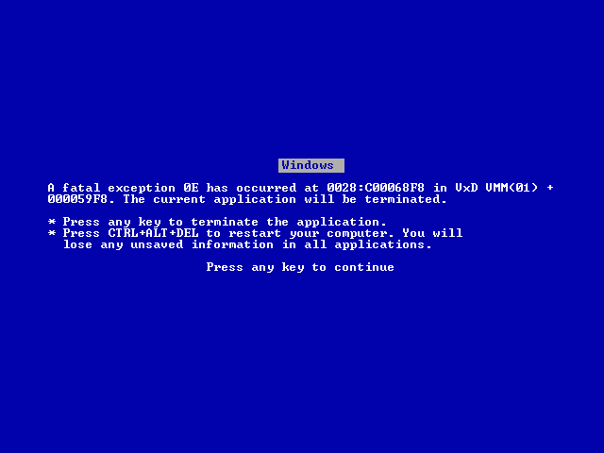
3.1.4 Failure Conditions and Software Levels (cont’d)
Level “E” Software

Slide 15
3.1.4 Failure Conditions and Software Levels (cont’d)
Minor
  Failure conditions which would not significantly reduce aircraft safety, and which would involve crew actions that are well within their capabilities. Minor failure conditions may include, for example, a slight reduction in safety margins or functional capabilities, a slight increase in crew workload, such as, routine flight plan changes, or some inconvenience to occupants.
Level D
  Software whose anomalous behavior, as shown by the system safety assessment process, would cause or contribute to a failure of system function resulting in a minor failure condition for the aircraft.

Slide 16
3.1.4 Failure Conditions and Software Levels (cont’d)
Notes on Level D Software
  Level D is the lowest “Certified” level of software
  In rare cases, Windows® has been given credit as Level D
  Many Electronic Flight Bag (EFB) applications are Level D
  Level D software has no assurance that it will work as intended; only that a process has been followed

Slide 17
3.1.4 Failure Conditions and Software Levels (cont’d)
Major
  Failure conditions which would reduce the ability of the crew to cope with adverse operating conditions to the extent that there would be, for example, a significant reduction in safety margins or functional capabilities, a significant increase in crew workload or in conditions impairing crew efficiency, or discomfort to occupants, possibly including injuries.
Level C
  Software whose anomalous behavior, as shown by the system safety assessment process, would cause or contribute to a failure of system function resulting in a major failure condition for the aircraft.

Slide 18
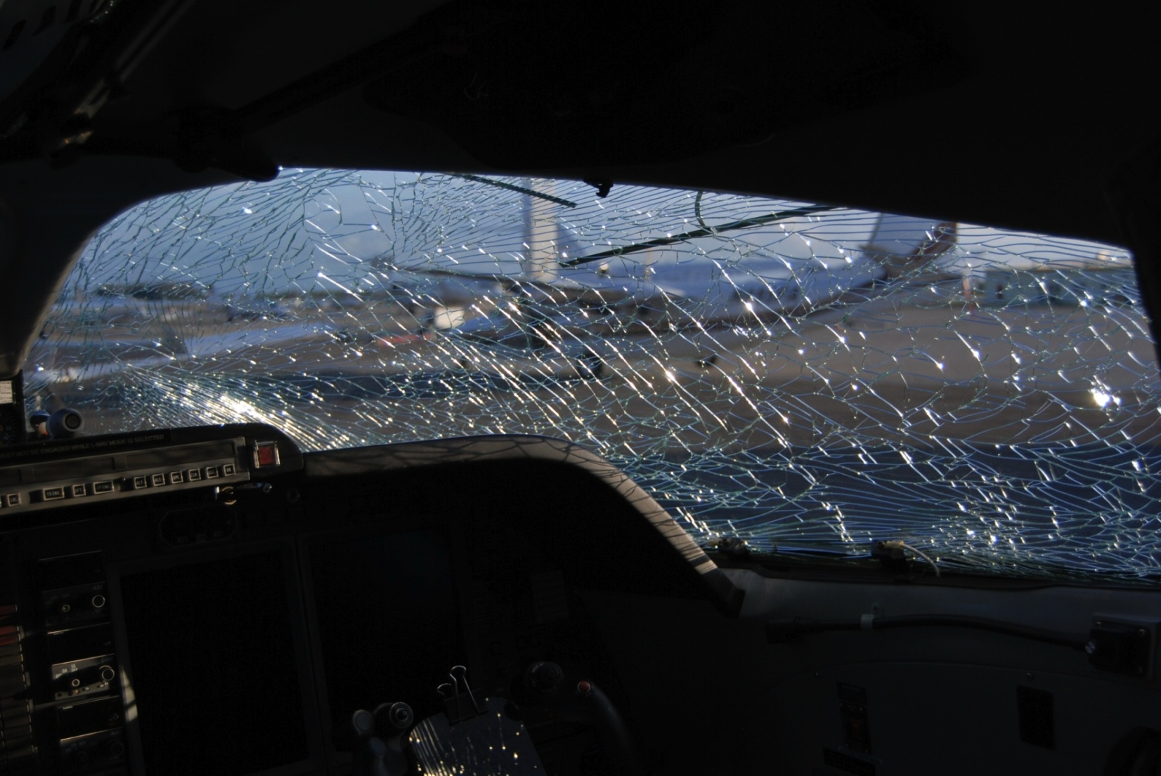
3.1.4 Failure Conditions and Software Levels (cont’d)
“Major” Failure Condition
Figure 3.1.2 – broken window

Slide 19
3.1.4 Failure Conditions and Software Levels (cont’d)
Notes on Level C Software
  Most navigation systems (GPS, FMS, INS) use Level C software
  Generally, Level C software may fail, but cannot provide hazardously misleading information
  Every line of Level C source code must be traceable to a functional requirement

Slide 20
3.1.4 Failure Conditions and Software Levels (cont’d)
Hazardous/Severe-Major
  Failure conditions which would reduce the capability of the aircraft or the ability of the crew to cope with adverse operating conditions to the extent that there would be:
    (1) a large reduction in safety margins or functional capabilities,
    (2) physical distress or higher workload such that the flight crew could not be relied on to perform their tasks accurately or completely, or
    (3) adverse effects on occupants including serious or potentially fatal injuries to a small number of those occupants
Level B
  Software whose anomalous behavior, as shown by the system safety assessment process, would cause or contribute to a failure of system function resulting in a hazardous/severe-major failure condition for the aircraft.

Slide 21

3.1.4 Failure Conditions and Software Levels (cont’d)
“Hazardous/Severe-Major” Failure Condition
Figure 3.1.3

Slide 22
3.1.4 Failure Conditions and Software Levels (cont’d)
Notes on Level B software
  Some autopilot and auto-throttle systems are Level B
  Level B software is similar to level C, but with an additional level of Verification and Validation (V&V) Independence

Slide 23
3.1.4 Failure Conditions and Software Levels (cont’d)
An aside on V&V
  Verification is a Quality control process that is used to evaluate whether or not a product, service, or system complies with regulations, specifications, or conditions imposed at the start of a development phase. Verification can be in development, scale-up, or production. This is often an internal process.
  Validation is a Quality assurance process of establishing evidence that provides a high degree of assurance that a product, service, or system accomplishes its intended requirements. This often involves acceptance of fitness for purpose with end users and other product stakeholders.

Slide 24
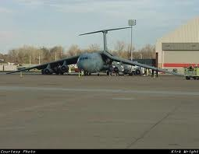
3.1.4 Failure Conditions and Software Levels (cont’d)
Catastrophic
  Failure conditions which would prevent continued safe flight and landing.
Level A
  Software whose anomalous behavior, as shown by the system safety assessment process, would cause or contribute to a failure of system function resulting in a catastrophic failure condition for the aircraft.
Figure 3.1.4 – Crash

Slide 25
3.1.4 Failure Conditions and Software Levels (cont’d)
Notes on Level A software
  Core EFIS display functions, auto-land autopilots and FADEC systems are generally Level A
  Every byte of Level A source code must be traceable to a software requirement
  Level A software requires the use of specialized and certified compilers, operating systems, and tools

Slide 26
3.1.5 Failure Severity vs. Probability
There are implied probabilities associated with various Failure Condition categories (and software Levels).
  FAA AC-23.1309-1D has an excellent summary
  The following slides give a simplified overview of these considerations.

Slide 27
3.1.5 Failure Severity vs. Probability (cont’d)
Probable Failure Conditions
  > 10⁻⁵
  Probable failure conditions are those anticipated to occur one or more times during the entire operational life of each airplane. Probable failure conditions are those having a probability on the order of 1 x 10⁻⁵ or greater
  Minor failure conditions may be probable.
  Human performance is typically assumed to fall in the “probable” failure range (10⁻³) for reliability calculations
  Level A, B, C, or D software may be used in these cases

Slide 28
3.1.5 Failure Severity vs. Probability (cont’d)
Improbable (Remote) Failure Conditions
  On the order of 1 x 10⁻⁵ to 1 x 10⁻⁷
  These are unlikely to occur to each airplane during its total life but may occur several times when considering the total operational life of a number of airplanes of the same type.
  Major failure conditions must be no more frequent than improbable (remote).
  Level A, B, or C software may be used in these cases

Slide 29
3.1.5 Failure Severity vs. Probability (cont’d)
Improbable (Extremely Remote) Failure Conditions
  1 x 10⁻⁹ < 1 x 10⁻⁷
  These are unlikely to occur when considering the total operational life of all airplanes of the same type, but nevertheless has to be considered as being possible
  Hazardous / Severe Major failure conditions must be no more frequent than Improbable (Extremely Remote).
  Only Level A or B software may be used in these cases

Slide 30
3.1.5 Failure Severity vs. Probability (cont’d)
Extremely Improbable Failure Conditions
  < 1 x 10⁻⁹
  These are so unlikely that they are not anticipated to occur during the entire operational life of all airplanes of one type.
  Catastrophic failure conditions must be shown to be Extremely Improbable.
  Level A software must be used in these cases

Slide 31
3.1.5 Failure Severity vs. Probability (cont’d)
Level of Software | Failure Conditions | Probability
Level E | No Effect | < 1 x10⁻⁵
Level D | Minor | > 1 x10⁻⁵
Level C | Major | 1 x 10⁻⁵ < 1 x 10⁻⁷
Level B | Hazardous/Severe-Major | 1 x 10⁻⁹ < 1 x 10⁻⁷
Level A | Catastrophic | < 1 x 10⁻⁹

Slide 32
3.1.6 Summary
The category of each system Failure Condition is determined through a rigorous System Safety Assessment (SSA) process.
AC 25.1309-1D (among others) matches this category to an acceptable probability of failure.
RTCA/DO-178B assigns a Software Level, and associated processes, to the Failure Condition.
DO-178B makes the assumption that the assigned processes will, without further proof, achieve the required reliability levels corresponding to the Failure Condition.

Slide 33

Questions?

Slide 34
References
RTCA/DO-178B "Software Considerations in Airborne Systems and Equipment Certification"

Slide 35
Images References
Figure 3.1.1: http://tinyurl.com/3gumapb
Figure 3.1.2: Courtesy of John Maris
Figure 3.1.3: http://tinyurl.com/3uewqko
Figure 3.1.4: http://tinyurl.com/3p2td2b

